Slide 1
SUNIL S
B.Tech AI & DS
SINCET
NAAN MUDHALVAN PROJECT

Slide 2
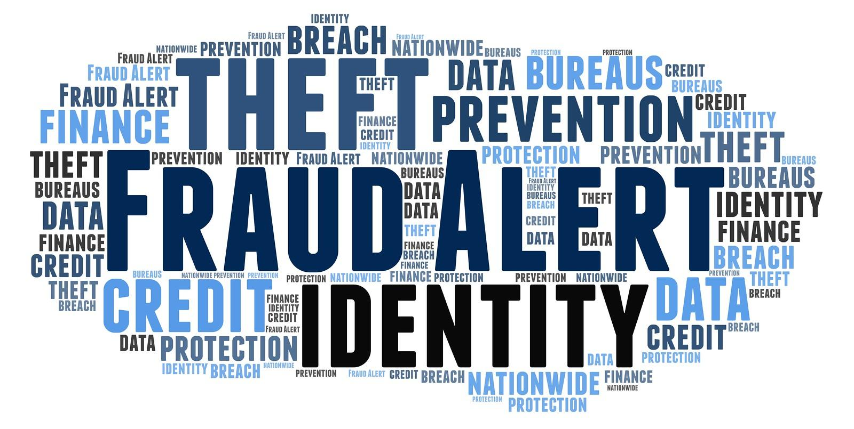
FRAUD DETECTION IN FINANCIAL TRANSACTION USING CNN

Slide 3


AGENDA
Welcome and Introduction to the Project
Overview of Fraud Detection in Financial Transactions
Importance and Relevance of CNN in Fraud Detection
Challenges in Fraud Detection
Scope and Objectives of the Project
3/21/2024 Annual Review

Slide 4

PROBLEM STATEMENT
Financial fraud poses a significant threat to the integrity and stability of financial systems worldwide.
As technology advances, fraudsters continually evolve their methods, making it increasingly challenging for traditional fraud detection systems to keep pace.
In this context, the utilization of deep learning techniques, particularly Convolutional Neural Networks (CNNs), offers a promising avenue for enhancing fraud detection accuracy.

Slide 5

PROJECT OVERVIEW
In this project, CNN, a powerful deep learning algorithm primarily utilized in image recognition tasks, is applied innovatively to the domain of financial transactions.
By treating transactional data as image-like matrices, CNN can efficiently extract intricate patterns and anomalies, enhancing the accuracy of fraud detection.
The project encompasses various stages, including data preprocessing, feature extraction, model training, and evaluation.

Slide 6

WHO ARE THE END USERS?
Financial Institutions
Customers
Regulatory Authorities
Law Enforcement
Security Analysts
Financial auditors
Insurance companies
Financial technology startups
E-commerce platforms
Payment processors

Slide 7

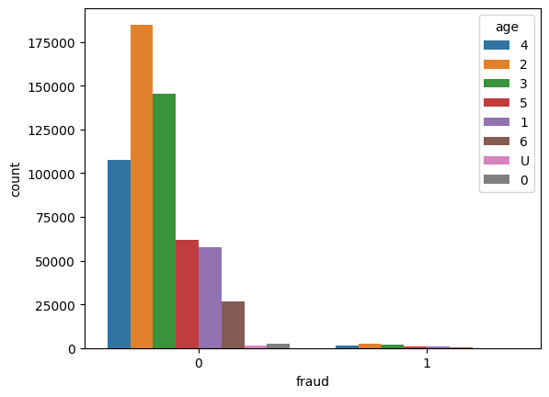
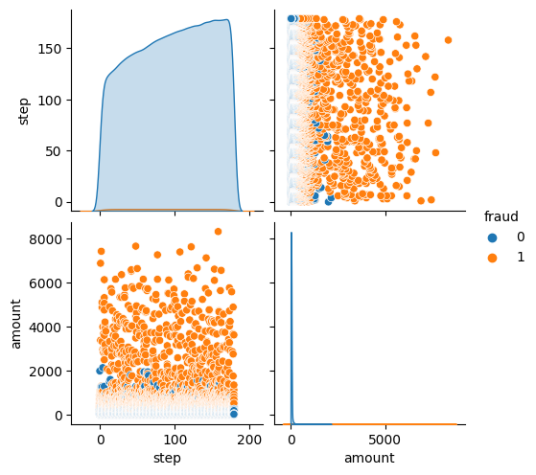
SOLUTION AND ITS VALUE PROPOSITION
Amount and fraud count
Fraud and Count

Slide 8
THE WOW IN YOUR SOLUTION
Leveraging CNN: Cutting-Edge Fraud Detection in Financial Transactions.
Revolutionizing Fraud Detection: CNN Solutions for Financial Transaction Security.
Breaking Boundaries: CNN-Based Fraud Detection in Financial Transactions.
Unveiling the Power of CNNs: Advanced Fraud Detection in Financial Transactions.
‹#›

Slide 9
MODELLING
Data Preprocessing: Data Cleaning: Remove or impute missing values, handle outliers.
Data Representation: Convert transaction data into a suitable format for CNN input. For example, for 1D CNN, you might represent each transaction as a time series sequence.
Model Architecture: Define a Convolutional Neural Network (CNN) architecture suitable for the task. Model Training:Split the data into training,validation,and test sets.
‹#›

Slide 10
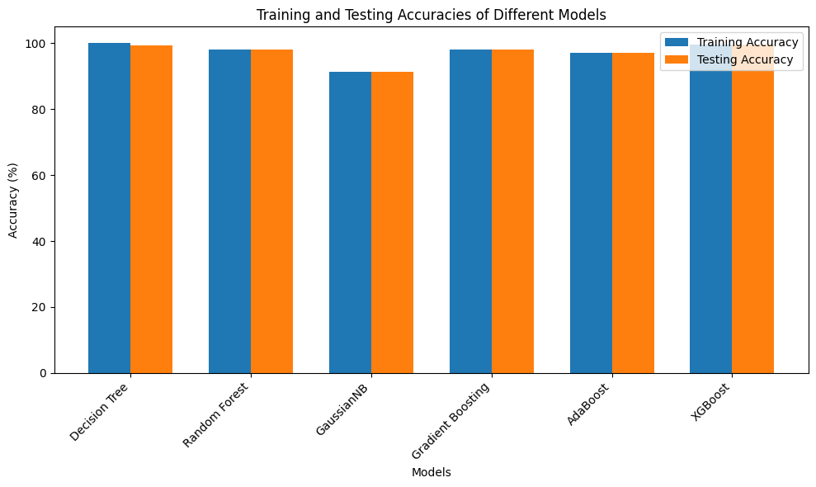
RESULTS
Training and testing of accuracies of different models
‹#›

